Slide 1

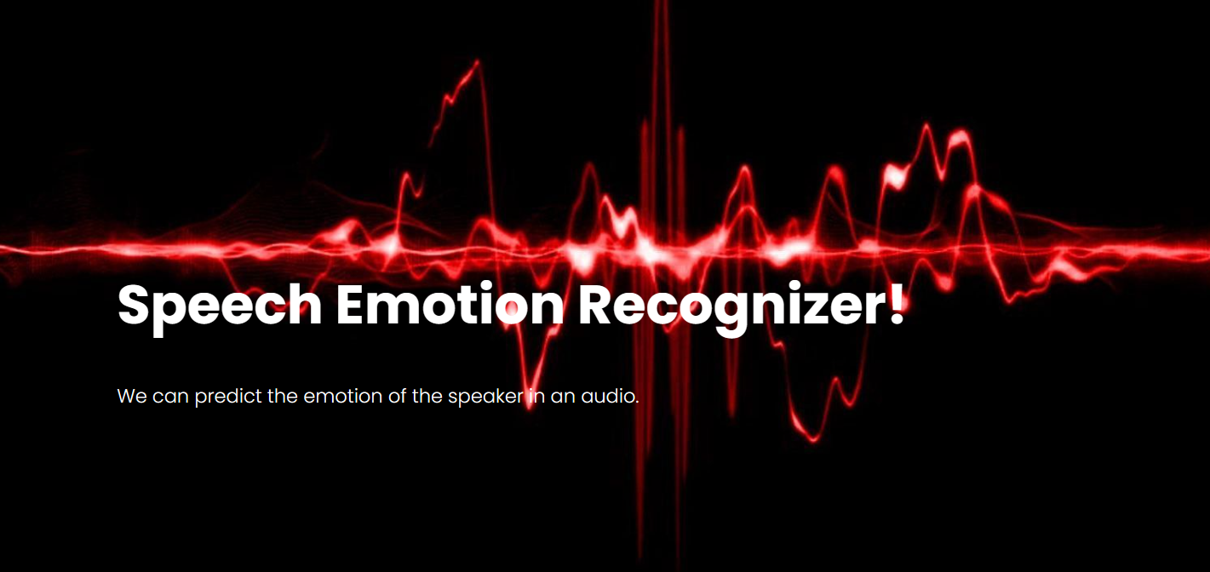
<
EMOTION RECOGNITION USING SPEECH PROCESSING
Under the guidance of Kavya G Assistant Professor TEAM MEMBERS 321910307004 – B. Harsha Vardhan Reddy 321910307015 – G. Mahendra Reddy 321910307034 – M. Lokesh 321910307039 – A. Jagadeesh 321910307059 – K. Balu Reddy

Slide 2
Index
Abstract
Introduction
Literature review
Existing Method
Drawbacks
Proposed method
Advantages
Class diagrams
Results
Conclusion
References

Slide 3
Abstract
In human machine interface application, emotion recognition from the speech signal has been research topic since many years. Emotions play an extremely important role in human mental life. It is a medium of expression of one's perspective or one's mental state to others. Speech Emotion Recognition (SER) can be defined as extraction of the emotional state of the speaker from his or her speech signal. There are few universal emotions- including Neutral, Anger, Happiness, Sadness etc in which any intelligent system with finite computational resources can be trained to identify or synthesize as required. In this work, we are extracting Mel-frequency cepstral coefficients (MFCC), Chromogram, Mel scaled spectrogram in conjunction with Spectral contrast and Tonal Centroid features. Deep Neural Network is used to classify the emotion in this work.

Slide 4
Introduction
There are many ways of communication but the speech signal is one of the fastest and most natural methods of communications between humans.
Humans have the natural ability to use all their available senses for maximum awareness of the received message.
The emotional detection is natural for humans but it is very difficult task for machine.
Therefore the purpose of emotion recognition system is to use emotion related knowledge in such a way that human machine communication will be improved.

Slide 5
To understand an image and generate captions, we are proposing a Deep learning based method.
Deep learning can provide increased accuracy and decrease in computational power.
Deep neural network (DNN) has unprecedented success in the field of speech recognition and image recognition.
We found that the DNN in speech emotion processing has a huge advantage.
We used DNN to train a 5-layer-deep network to extract speech emotion features.

Slide 6
Softmax is used for the classification of the images in the output layer.
The all possible emotions that our model predicts are neutral, calm, happy, sad, angry, fearful, disgusted and surprised.
We have used RAVDASS speech dataset with 24 persons have 1440 audio files combined for training.
Automatic emotion recognitions from the human speech are increasing now a day as it results in the better interactions between human and machine.

Slide 7
Literature review
S. NO | Journal Type with year | Authors | Title | Outcomes
1 | Proceedings of the 26th International Conference on Neural Information Processing Systems (2013) | Szegedy, Christian & Toshev, Alexander & Erhan, Dumitru | Deep neural networks for object detection | Fundamentals of DNN and Object detection in any image.
2 | University of TAHRI Mohamed (2019) | Benk, Sal & Elmir, Youssef & Dennai, Abdeslem | A Study on Automatic Speech Recognition | Fundamentals of speech recognition and implementation.

Slide 8
S. NO | Journal Type with year | Authors | Title | Outcomes
3 | International Journal of Soft Computing and Engineering (IJSCE) (2012) | Ashish B. Ingale & D. S. Chaudhari | Speech Emotion Recognition | Audio feature extraction like mfcc, mel etc and their importance for emotion detection.
4 | Mathematical Problems in Engineering, vol. (2014) | Chenchen Huang, Wei Gong, Wenlong Fu, Dongyu Feng | A Research of Speech Emotion Recognition Based on Deep Belief Network and SVM | Importance of DNN for speech emotion recognition.

Slide 9
Existing method
In most of the currently available systems, the model used for emotion recognition uses traditional Machine learning algorithms.
The algorithm like Support Vector Machines, KNN etc were used in the past.
The accuracies of these models are low.
There are deep learning models for emotion recognition but they are trained on large datasets and are complex to use.

Slide 10
Disadvantages in Existing method
Lower accuracies.
High computation complexities.
Requires high performance hardware to achieve a model with good accuracy.

Slide 11
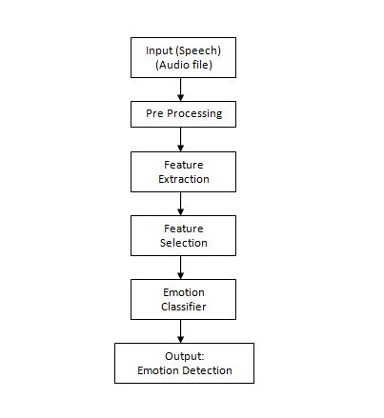
Proposed method

Slide 12
We propose a modified speech emotion recognition method which uses deep neural networks for training.
The method uses Mel-frequency cepstral coefficients (MFCC), Chromogram, Mel scaled spectrogram in conjunction with Spectral contrast and Tonal Centroid features to extract details about an audio file.
The dataset used here is the Ryerson Audio-Visual Database of Emotional Speech and Song (RAVDESS).

Slide 13
Advantages of Proposed method
Higher Accuracy.
Low computational complexities.
Does not requires very high performance hardware(s) to run.

Slide 14
Procedure
Upload the dataset of audio (.wav files) to be read using librosa library.
Data Preprocessing is a technique that is used to convert the raw data into a clean data set.
Cleaning the data refers to removing the null values, filling the null values with meaningful value, removing duplicate values, removing outliers, removing unwanted attributes.
If dataset contains any categorical records means convert those categorical variables to numerical values.
In total our model in 5 layers deep.

Slide 15
The extracted features are Mel-frequency cepstral coefficients (MFCC), Chromogram, Mel scaled spectrogram in conjunction with Spectral contrast and Tonal Centroid features.
We split our dataset of 1440 audio files in 2 parts, training data with 1008 audio files and testing data with 432 audio files. Here 70% of the data is taken for the training dataset.
Deep learning can provide increased accuracy and decrease in computational power.
Deep Neural Network (DNN) is widely used in deep learning to train models for tasks which traditional machine learning algorithms cannot do or is hard to do.

Slide 16
An audio is uploaded by the user (which includes speech of a person), and the model is used to predict the emotion of the speaker in the audio.
A Flask architecture based web application is developed to use the model. It has 2 parts, the system and the user.
There is a user registration and login management system in the UI.
A new user first needs to register their details which includes name, email and the password. This user information is stored in MySQL database.

Slide 17
An already registered user, whose data is stored in the system's MySQL database can login to the web app using their valid credentials.
Once they successfully log in, only then they are provided access to the application to predict the emotions.
A Sequential() model with 5 layers is created.
Train dataset is used for training the dataset using 700 epochs.
The best one with respect to test accuracy is the model which we will use for prediction.

Slide 18
Class Diagram
In software engineering, a class diagram in the Unified Modeling Language (UML) is a type of static structure diagram that describes the structure of a system by showing the system's classes, their attributes, operations (or methods), and the relationships among the classes. It explains which class contains information.

Slide 19
Results
The proposed scheme presented an approach to recognize the emotion from the human speech.
This approach has been implemented by the using the neural networks.
We have successfully developed a deep learning model using the deep neural network architecture to predict the emotions of the speaker in an audio.
We have famed our project in a web based application using the Flask architecture. The UI also includes user registration system.
We were able to get a test accuracy of 73.4% using the trained model.

Slide 20
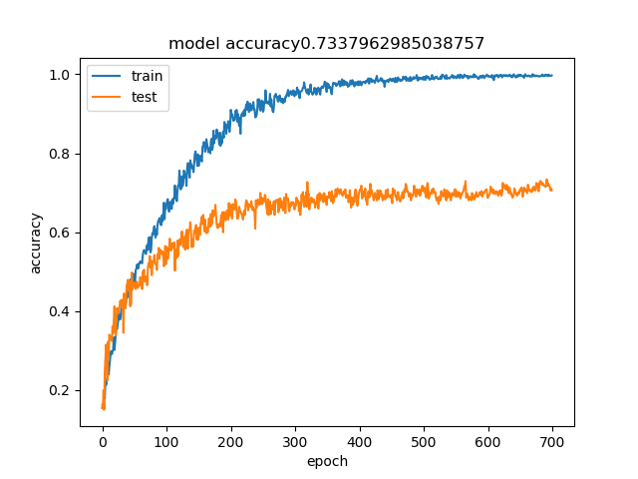
The train vs test accuracies of our model over 700 epochs are shown below:
The model gets the best test accuracy of 73.4%

Slide 21
Conclusion
Deep learning systems are able to generate good results.
We have successfully developed a deep learning model with 73.4% test accuracy in emotion recognition.
Please note that emotion prediction is subjective and the emotions rated by a person for the same audio can differ from person to person.
This is also the reason why the algorithm which is trained on human rated emotions can generate erratic results sometimes.
The model was trained of RAVDESS dataset, so the accent of the speaker can also lead to erratic results as the model is trained on North American accent database.

Slide 22
References
[1] Szegedy, Christian & Toshev, Alexander & Erhan, Dumitru. (2013). Deep Neural Networks for Object Detection. 1-9.
[2] Benk, Sal & Elmir, Youssef & Dennai, Abdeslem. (2019). A Study on Automatic Speech Recognition. 10. 77-85. 10.6025/jitr/2019/10/3/77-85.
[3] Ashish B. Ingale & D. S. Chaudhari (2012). Speech Emotion Recognition. International Journal of Soft Computing and Engineering (IJSCE) ISSN: 2231-2307, Volume-2 Issue-1, March 2012

Slide 23
[4] Chenchen Huang, Wei Gong, Wenlong Fu, Dongyu Feng, "A Research of Speech Emotion Recognition Based on Deep Belief Network and SVM", Mathematical Problems in Engineering, vol. 2014, Article ID 749604, 7 pages, 2014. https://doi.org/10.1155/2014/749604
[5] Livingstone SR, Russo FA (2018) The Ryerson Audio-Visual Database of Emotional Speech and Song (RAVDESS): A dynamic, multimodal set of facial and vocal expressions in North American English. PLoS ONE 13(5): e0196391.
[6] M. E. Ayadi, M. S. Kamel, F. Karray, “Survey on Speech Emotion Recognition: Features, Classification Schemes, and Databases”, Pattern Recognition 44, PP.572-587, 2011.

Slide 24
[7] I. Chiriacescu, “Automatic Emotion Analysis Based On Speech”, M.Sc. THESIS Delft University of Technology, 2009.
[8] T. Vogt, E. Andre and J. Wagner, “Automatic Recognition of Emotions from Speech: A review of the literature and recommendations for practical realization”, LNCS 4868, PP.75-91, 2008.
[9] S. Emerich, E. Lupu, A. Apatean, “Emotions Recognitions by Speech and Facial Expressions Analysis”, 17th European Signal Processing Conference, 2009.
[10] P.Shen, Z. Changjun, X. Chen, “Automatic Speech Emotion Recognition Using Support Vector Machine”, International Conference On Electronic And Mechanical Engineering And Information Technology, 2011.

Slide 25


